Slide 1
Library Skills
Search for Resources & Seek for Research Support

Slide 2
Outline
Search for Resources
Search the Library Catalogue
Search the Database
Seek for Research Support

Slide 3
Search for Resources
Search the Library Catalogue

Slide 4
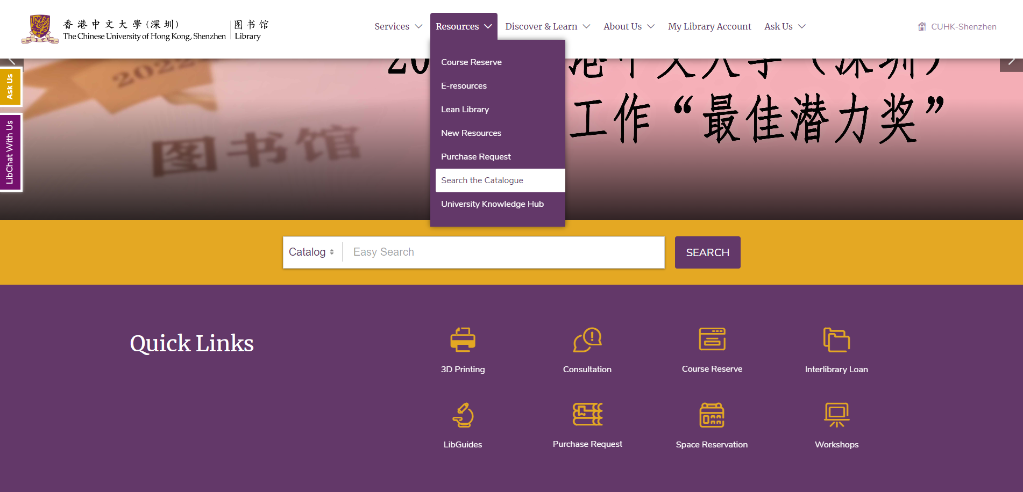
Print Collections
Notes:
You can search for all the materials in the Print Collections in the library catalogue. You can access the library catalogue from the library homepage, from the drop-down menu of Resources, or directly search in the search box on the library homepage.

Slide 5
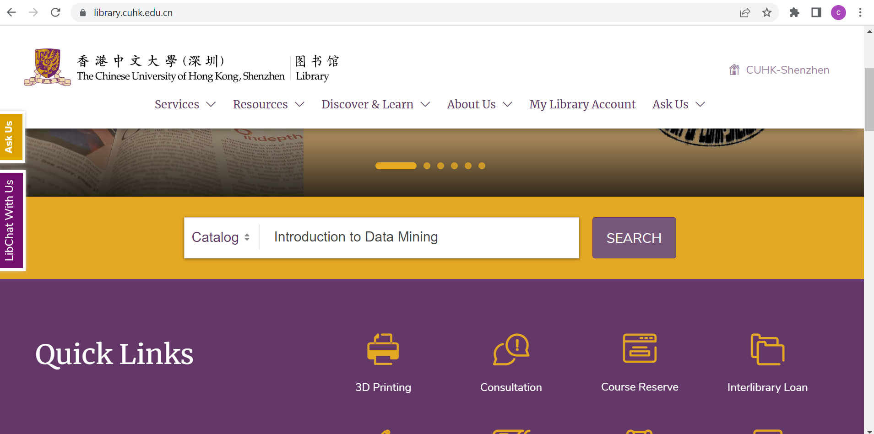
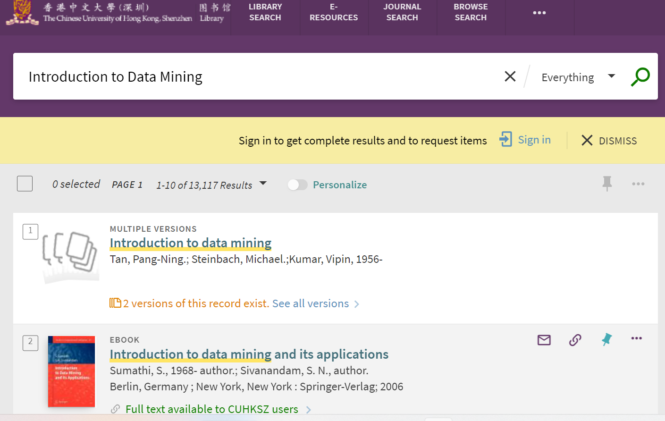
Print Collections
library.cuhk.edu.cn
Notes:
Open the library's official website and enter the book information you want to search for, such as "Introduction to Data Mining". Then, open the search results.

Slide 6
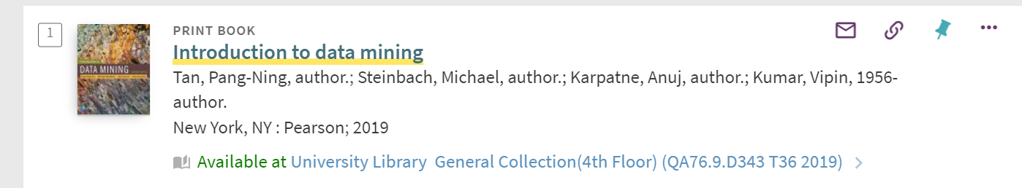
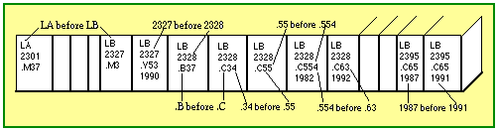
Print Collections
Material Type
Availability
Collection Type
Call Number
Notes:
For each entry of the search results, you will find important information such as material type- whether it is print or electronic, availability- whether it is on shelf or checked out, collection type- different collection types indicate different locations and different item policies, and call number- a set of letters and numbers that help patrons locate the book on shelf.
Books are shelved according to the call number. Therefore, in order to find a book on shelf, you need to learn how to read the call number. The first line is all letters, and is arranged alphabetically, namely, from A to Z. As you can see in the picture, LA is before LB. The second line is all numbers, and is arranged numerically, namely, from small to large. As you can see in the picture, 2327 is before 2328. The third line is a combination of letters and numbers. Letters are still arranged alphabetically. As you can see in the picture, .B is before .C. However, numbers are arranged decimally, which means the number is read as a decimal, and you compare the numbers in their decimal form. Technically, you can compare the number one unit by one unit. For example, in this picture, .554 is placed before .63. This is because you first compare 5 with 6. Because 5 is smaller than 6, .554 is placed before .63. The fourth line is the date of publication, and this line is arranged numerically. This picture does not show the copy/volume line. If there is such a line, it is arranged numerically.
6

Slide 7
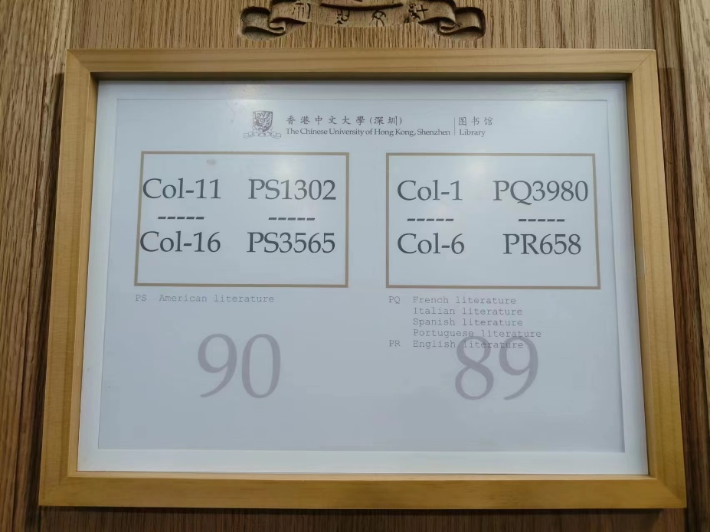
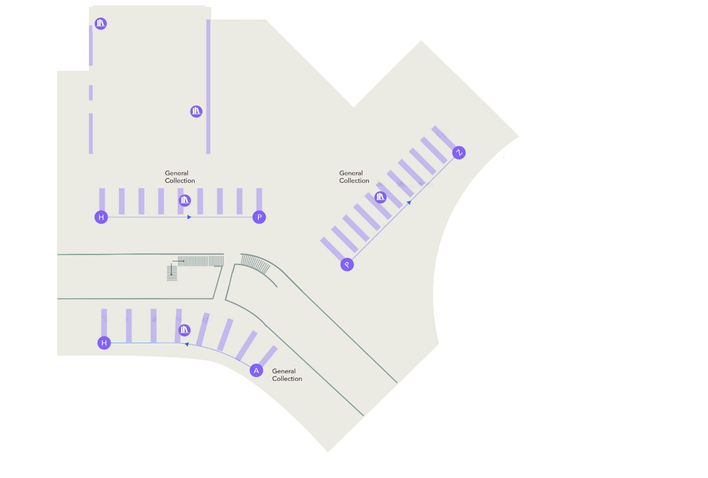
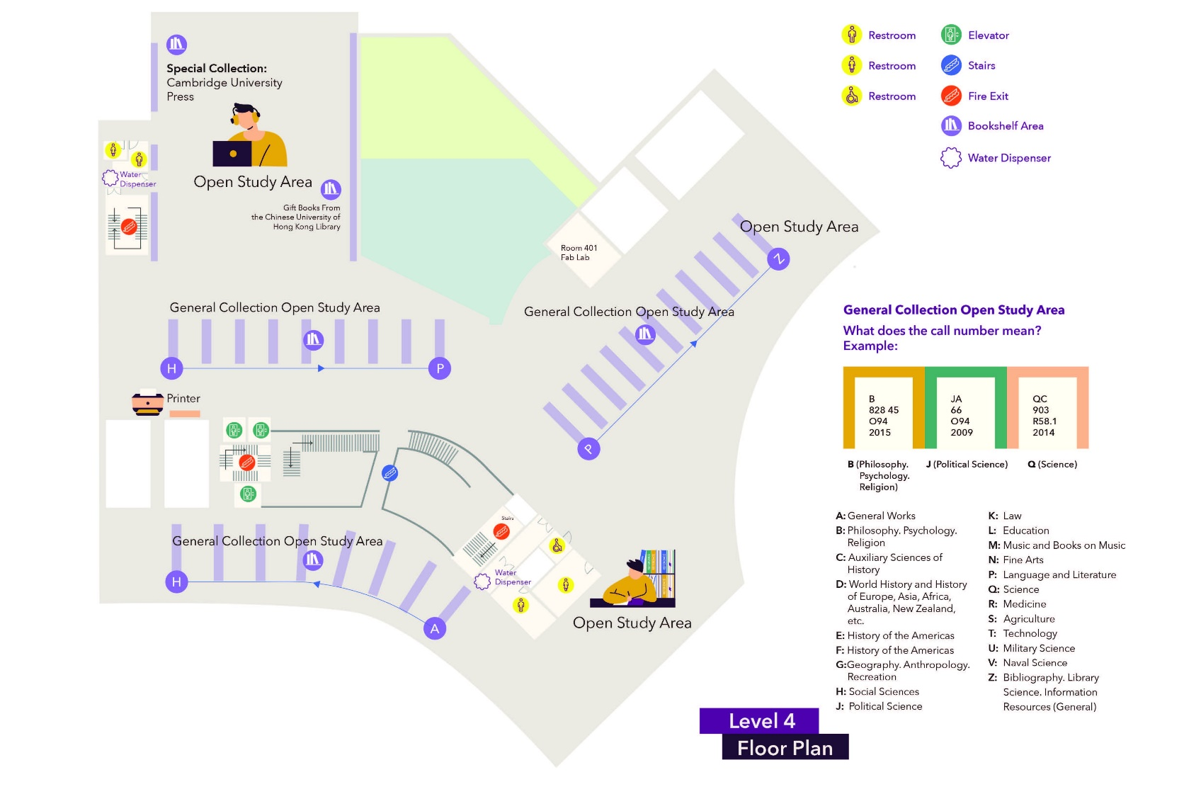
Print Collections
Notes:
The first two digits of the call number indicate the subject area of the books. For example, QA stands for Mathematics & Computer Science.
Most print books are in the General Collection on the fourth floor. You can find the distribution of print books by the initial letters of the call number on this slide.

Slide 8
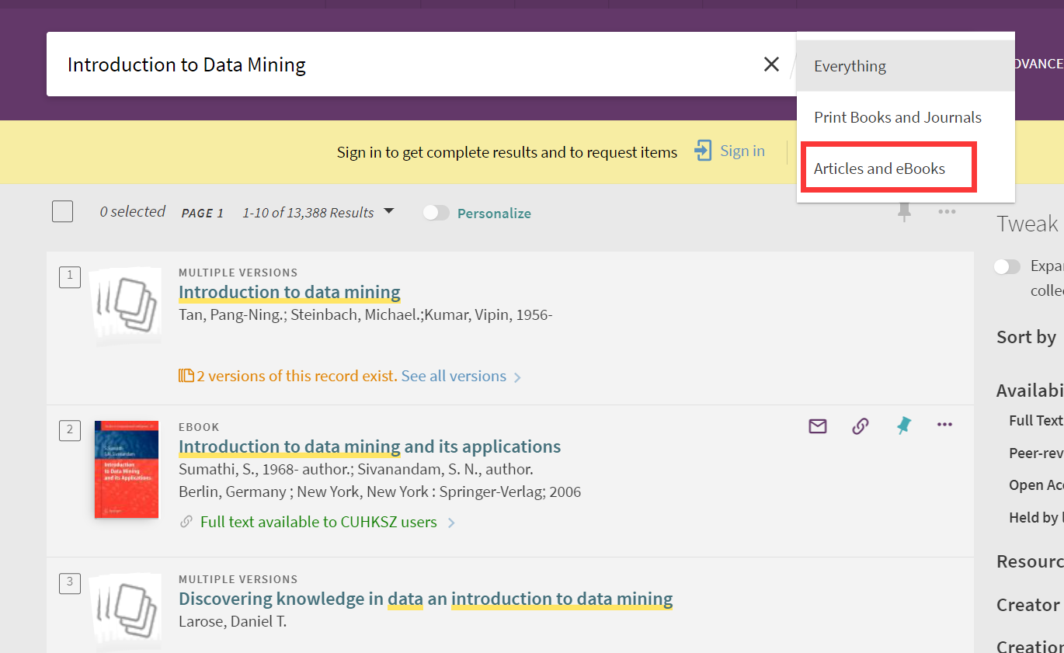
Electronic Collections
library.cuhk.edu.cn
Notes:
How to find electronic resources?
You can also directly search through the library's homepage search box, and then narrow the search scope down to "Articles and eBooks." Click through to find the resources you need.

Slide 9
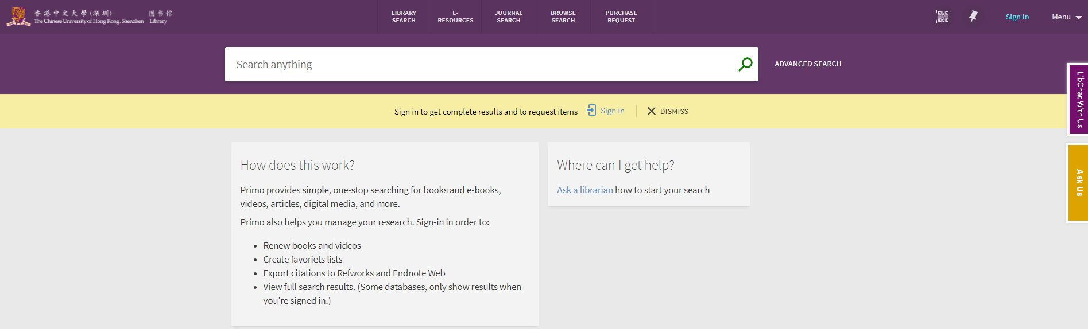
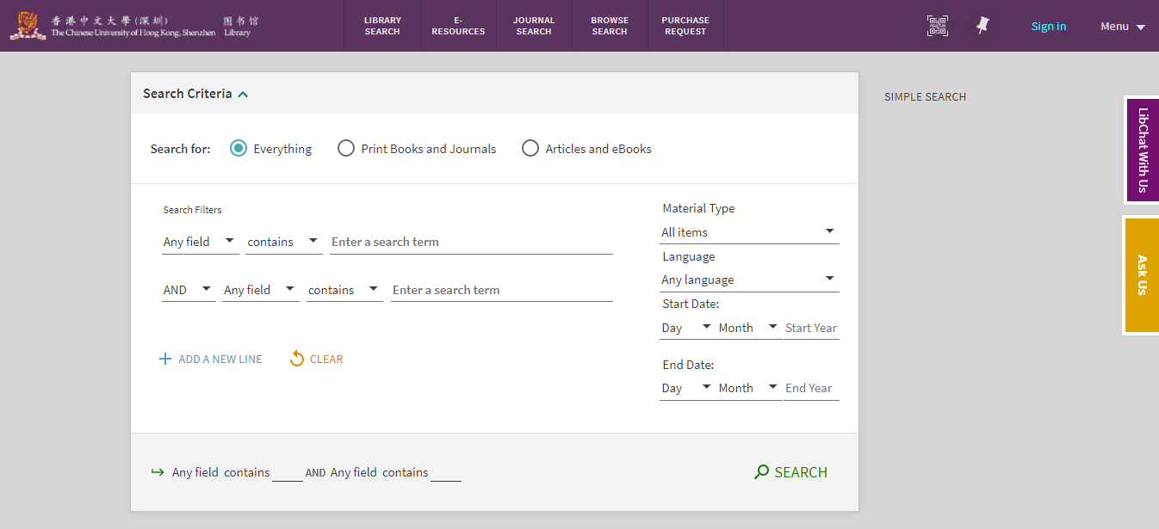
Advanced Search
Notes:
You can either do a simple search with keywords in the search box, or do an advanced search to get a more precise search result. The button Advanced Search is to the right of the search box.
In Advanced Search, first select the search scope- Under “Everything”, you can search for all resource types; Under “Print Books and Journals”, you can search for print resources; Under “Articles and eBooks”, you can search for electronic resources.
With Advanced Search, you can confine the fields of your search terms, for example, title, author, etc. You can also set Material Type, Language, and Publication Date in your search criteria.
9

Slide 10
Search for Resources
Search the Database

Slide 11
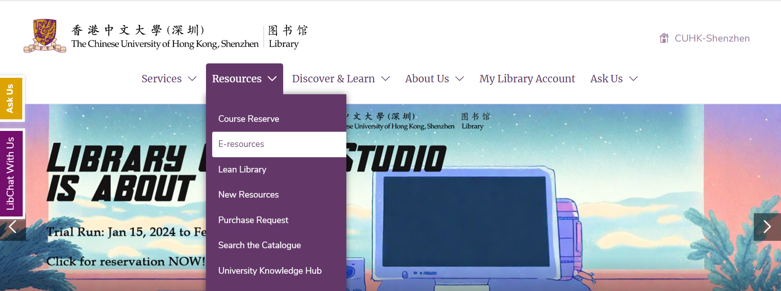
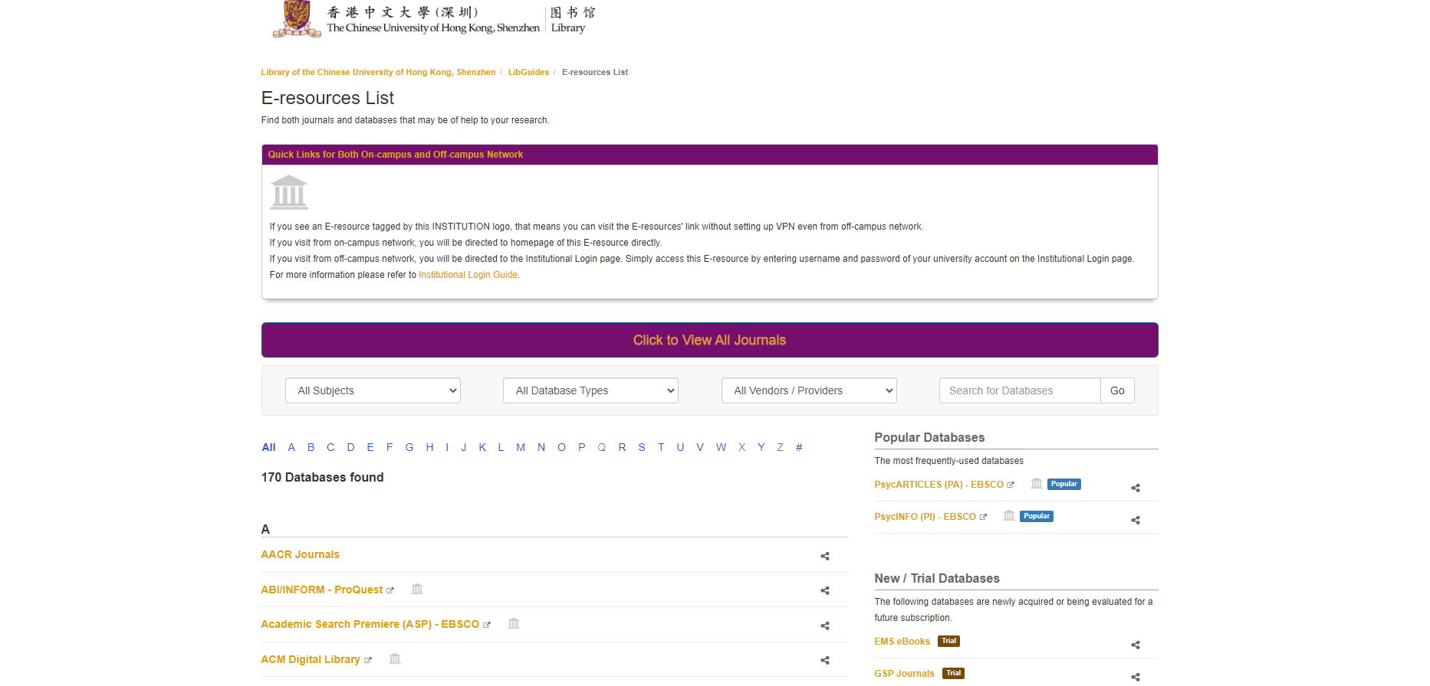
E- resources List
Notes:
You can find all the databases that Library has subscribed to in the E-resources List. You can access the E-resources List from the library homepage, also from the drop-down menu of Resources.
11

Slide 12
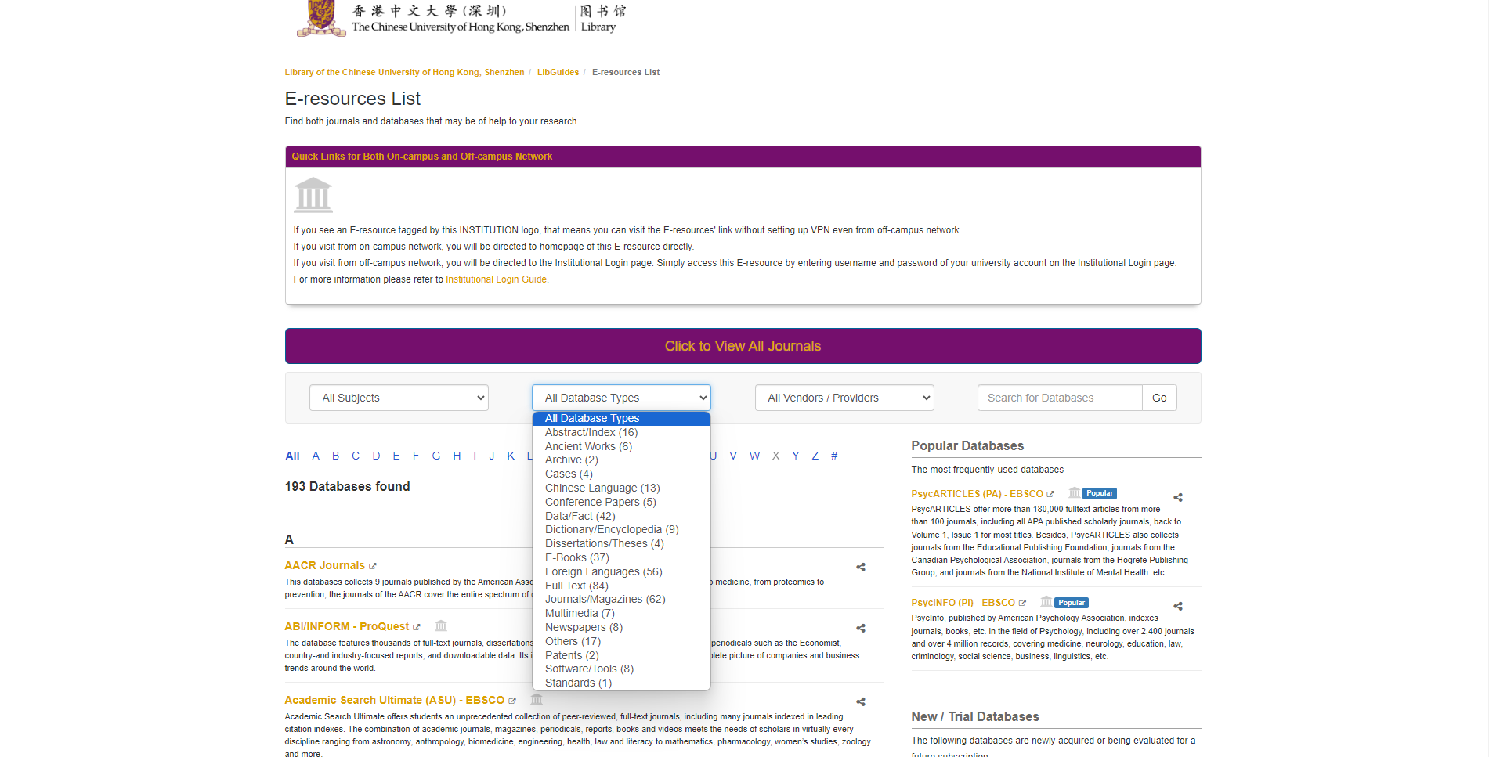
Database Types in the E-resources List
Notes:
In the E-resources List, library users can find all the databases that Library has subscribed to. There is a filter Database Types, in which you can find the common database types used in the academic circle. Filter by one type, and then you can find all the databases under that type.

Slide 13
Database Types in the E-resources List
3
1
Abstract/Index
Full Text
2
Chinese Language
Foreign Languages
Ancient Works
Archive
Cases
Conference Papers
Data/Fact
Dictionary/Encyclopedia
Dissertations/Theses
E-Books
Journals/Magazines
Multimedia
Newspapers
Others
Patents
Software/Tools
Standards
Notes:
These database types can be divided into three groups. The first one is grouped according to whether full text is provided or not- Abstract/Index Databases do not provide full text. The second one is grouped based on languages- whether the database collects materials in Chinese language or other foreign languages. The third one is resource types, such as books and journals.

Slide 14
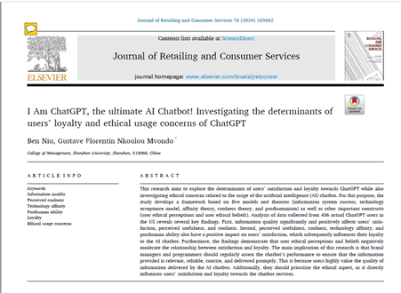
Abstract/Index
Description
It is an effective document-searching database.
Note
It only provides links, not the full text.
Function
Document Search
Notes:
What is an Abstract/Index database?
In general, it is a useful tool for looking through documents. But, it just provides links to documents, not the full text.
14

Slide 15
Abstract/Index
Database
Web of Science(WOS): https://www.webofscience.com/
The areas: science, social sciences, arts and humanities.
Scopus: https://www.scopus.com/
The areas: science, engineering and technology, medicine, and social sciences.
Notes:
Which databases are Abstract/Index databases?
Web of Science and Scopus are the most common databases.
Scopus: https://www.scopus.com/
It covers documents in the areas of science, engineering and technology, medicine, and social sciences.
Web of Science: https://www.webofscience.com/
It mainly covers documents in the areas of science, social sciences, arts and humanities.
15

Slide 16
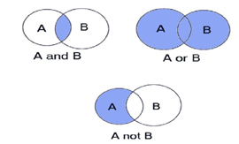
Abstract/Index
WOS Search Skills
Basic Search 【Demo】
Advanced Search 【Demo】
More Search Skills: http://webofscience.help.clarivate.com/en-us/Content/advanced-search.html
Scopus Search Skills
https://service.elsevier.com/app/answers/detail/a_id/34325/
Booleans | AND、OR、NOT
Field Tags | TI、AU、AD
Exact Phrase | “”
Wildcard | *、？、$
【Skip Demo】
Notes:
So how do we do a document search in these databases? Let's take Web of Science as an example for one study. First of all, let's understand the basic search way.
1. Open the homepage of Web of Science, you will see a search box. In the search box, we can enter the keywords, authors, journal name, and other information. Click the Search button.
2. The search results will be displayed on a new page. You can further filter and sort them as required. For example, filter by year of publication, author, journal, etc.
3. By clicking the title of the article in the search result, we can see the detailed information of the article, including the abstract, authors, journal name, citation frequency, and so on.
4. We can also select "Analyze" in the navigation bar at the top of the search results page for more in-depth analysis and visualization, such as generating citation reports, analyzing author collaboration networks, and so on.
How do we search in an advanced way?
Open the homepage of Web of Science and you will see an Advanced Search tab. Click on it.
After entering the Advanced Search page, we can specify the search criteria in a more precise way. For example, Boolean operators, field codes, exact phrases, and wildcards.
- Boolean Operators: they are logical operators used in the search process. The common Boolean operators are AND, OR, and NOT. They are used to link keywords or search terms to build more complex searches.
AND is used for search results that contain two or more keywords or search terms at the same time.
OR is used for search results that contain any one keyword or term.
NOT is used to exclude search results that contain a specific keyword or term.
- Field Codes: they are used to specify specific fields or attributes to be searched for in a search. In some databases or search engines, field codes can be used to limit the search results to matches in specific fields. For example, in Web of Science, "TI" is for Title, "AU" is for Author, "AD" is for Address, and so on.
- Exact Phrase: it is a specific phrase or word group consisting of multiple keywords that need to appear in the exact same order and form in a search. Enclose the keyword in inverted commas to instruct the search engine to match it as an exact phrase. This is useful for limiting search results to literature that contains specific phrases.
- Wildcard: A wildcard is a symbol used to replace one or more characters in a search. Common wildcards are the asterisk (*), question mark (?), and the dollar sign ($). An asterisk denotes any sequence of characters (including empty sequences). The question mark represents any single character. The dollar sign $ represents only zero or one character. Using wildcards extends the search to find related documents with imperfect matches. The dollar sign $ represents zero or one character only in Web of Science.
For more search skills, we can access this link: http://webofscience.help.clarivate.com/en-us/Content/advanced-search.html
16

Slide 17
Abstract/Index
Lean Library
Lean Library is a browser plug-in that works with our library system to automatically identify E-Resources that we have already subscribed to.
Link: https://library.cuhk.edu.cn/lean-library
Notes:
Since we cannot access full text directly from the Abstract/Index database. So after we find a document we want to read, how can we know whether it is in our library's collection and how can we get the full text? I would like to introduce a very useful tool, Lean Library, which can help us solve this problem. Lean Library is a plug-in for your web browser. It can easily access the e-resources that the library subscribes to automatically. The details of how to get it can be obtained from the link on the PPT.
17

Slide 18
Full Text
Ancient Works 【Demo】
Archive 【Demo】
Cases
Conference Papers
Dissertations/Theses
E-Books 【Demo】
Journals/Magazines
Newspapers
Patents
Standards
【Skip Demo】
Notes:
On this slide, you can find the resource types that provide full text.
By ancient works, we mean Chinese classical texts. Databases of this type normally provide not only photocopies of the original texts, but also texts that can be copied and pasted.
【Demo】 Take the database 爱如生典海平台 as an example. Select 典海古代典籍, and then click on 登录. Search for the keyword 孔孟 in the sub-database 中国基本古籍库. Choose the first entry, and log in to your personal account, so that you can access the content. As you can see, the left side of the screen is the photocopy of the original texts, and if you want to copy the texts, please click on 下载.
Archives are collections of historical materials. While some databases of this type provide not only photocopies, but also PDF documents of the original texts, others only provide photocopies.
【Demo】 Take the database Global Commodities as an example. In the section Documents, select the document you would like to download, say, the first one. Open this entry, and you can find the button “Download entire document as PDF”. The file downloaded is a PDF document of the original texts.
Case studies, normally referred to as intensive observations of particular cases, are frequently cited in research projects as well, such as business cases and legal cases. Cases are normally provided in the format of PDF documents.
A conference paper, by its name, is a paper presented at a conference. Conference papers are normally provided in the format of PDF documents.
Generally, dissertations and theses refer to the papers written for an academic degree. While a dissertation is commonly required to obtain a doctoral degree, a thesis is commonly required to obtain a master’s degree. Dissertations and theses are normally provided in the format of PDF documents.
Academic books include monographs- a research project focusing on a single subject and usually conducted by one single author, edited volumes- a combined research project conducted by multiple authors, and reference books, such as dictionaries, encyclopedias, handbooks, annals, atlas, etc. Monographs and edited volumes are normally provided in the format of PDF documents. However, reference books are of two different conditions. While some reference books are also provided in the format of PDF documents, others are provided as entries searchable by the search engine provided in the database.
【Demo】 Take the database Britannica Academic as an example. Search for the keyword “graphene”, you will find articles, images & videos, etc. regarding this keyword in a webpage format.
Both journals and magazines are periodical publications containing news or articles elaborating on certain topics. While a magazine is a periodical that contains articles pertaining to current events or general interest topics, a journal usually refers to a scholarly periodical that contains articles aimed at researchers or specialists. Journals and magazines are normally provided in the format of PDF documents.
Newspapers refer to printed publications, usually issued daily or weekly, consisting of folded unstapled sheets and containing news, advertisements, etc. While some databases provide both photocopies and PDF documents of the original publications, others provide either photocopies or PDF documents.
A patent is a government grant to an inventor of the right to exclude others from making, using, or selling an invention, usually for a limited period. In China, patents are categorized into Inventive, Design, and Utility Model. Patents are normally provided in the format of PDF documents.
A standard is an established norm or requirement for a repeatable technical task that is applied to a common and repeated use of rules, conditions, guidelines, or characteristics for products or related processes and production methods, and related management systems practices. The categories of standards in China include Industry standards, government standards, etc. Standards are normally provided in the format of PDF documents.

Slide 19
Full Text
ScienceDirect 【Demo】
E-Books (including Conference Proceedings)
Journals
What types of articles are available in ScienceDirect? - ScienceDirect Support Center (elsevier.com)
【Skip Demo】
Notes:
Take the database ScienceDirect as an example. This database collects the full text of E-books (including Conference Proceedings) and Journals.
【Demo】 Search for the keywords “Artificial Intelligence”. From the panel on the left side of the result list page, you can find many articles types of the search results. These article types are the sub-categories of E-books (including Conference Proceedings) and Journals. You can find detailed explanations of these article types in the website link shown on this slide.

Slide 20
Full Text
CNKI 【Demo】
Conference Papers
Dissertations/Theses
E-Books
Journals/Magazines
Newspapers
Patents
Standards
【Skip Demo】
Notes:
Take the database CNKI as an example. This database collects the full text of conference papers, dissertations & theses, E-books, journals/magazines, newspapers, patents, standards, etc.
【Demo】 Select all the resource types, and search for the keyword “人工智能”. In the result list page, you can find documents available of types such as journals, dissertations/theses, patents, etc.

Slide 21
Data/Fact
Description
It is a database that can provide specific data resources.
Resources: Scientific and Technical Data, Social Resource Data, Business and Economic Data, Geographic and Environmental Data, Arithmetic Formulas, Graphs, Tables, etc.
Note
Most of our library data databases are SME subjects.
Notes:
What is a Data database?
It is a database that can provide specific data resources. It can provide different data, such as scientific and technical data, social resources data, business and economic data, geographic and environmental data, and it also provides formulas, graphs, tables, etc. Most of the Data databases available in our library belong to SME subjects.
21

Slide 22
Data/Fact
Database
Wharton Research Data Service (WRDS)：https://wrds-web.wharton.upenn.edu/
中国研究数据服务平台 (CNRDS)：https://www.cnrds.com/Home/Login
Notes:
Today we will focus on two data databases: Wharton Research Data Service (WRDS) and 中国研究数据服务平台 (CNRDS).
22

Slide 23
Data/Fact
Wharton Research Data Service(WRDS)
It is a data platform.
Area: Finance, Accounting, Economics, and Management
Notes:
WRDS is a data platform that provides access to our various resources in the areas of finance, accounting, economics, and management.
23

Slide 24
Data/Fact
Wharton Research Data Service(WRDS) 【Demo】
Database selection: CRSP, Compustat, IBES
Data Set Selection
Variable Selection
Data Export
Documents and Help Services
【Skip Demo】
Notes:
We can learn some search skills for it: 1. Database selection: There are several databases to choose from on the WRDS platform, including CRSP, Compustat, IBES and so on. We can choose the suitable database for searching according to the research needs. 2. Data set selection: There are many datasets available in each database. For example, in CRSP database, different stock market datasets can be selected. Understanding the coverage and content characteristics of each dataset can help us to select the dataset for our study. 3. Variable selection: While performing data retrieval, select the appropriate variables according to the purpose of our study. Understand the definition and meaning of each variable and the time frame and frequency available. 4. Data Export: The WRDS platform allows users to export retrieved data locally for further analysis. We need to ensure that the appropriate data export format is selected and that the appropriate data morphing and processing options are chosen as required. 5. Documentation and help resources: The WRDS platform provides documentation, user guides, and online help resources for understanding the structure of the database, variable definitions, data retrieval methods, and functionality. Consult these resources to better understand and utilise the functionality and data resources of the WRDS platform.
24

Slide 25
Data/Fact
中国研究数据服务平台 (CNRDS)
It is a data platform that provides China-related data.
Areas: Chinese Economy, Finance and Business Studies.
Notes:
中国研究数据服务平台 is a data platform that provides China-related data. It mainly includes data on China's economy, finance, and business studies.
25

Slide 26
Data/Fact
中国研究数据服务平台 (CNRDS) 【Demo】
Institutional Login: https://www.cnrds.com/Home/Login
Select the base database :
Data Set Selection
Variable Selection
Data Export
Listed Company Stock Basis Database
Listed Company Financial Database
Listed Company Governance Database
Economic Research Database
【Skip Demo】
Notes:
Let's learn about its search skills. Firstly, we need to select the "Institutional Login" tab. Then, please select the base database. This is the database that we are sure to access. The database is divided into four parts:
The first is the basic data of listed companies' stocks. It mainly includes data related to China's stock market, such as share price data, financing and securities data, and equity financing data.
The second is listed company financial data. It mainly includes financial data of listed companies in China, such as financial statement data, profit forecast data, and financial indicator data.
The third is listed company governance basic data. It includes listed company data related to corporate governance, such as connected transactions, insider transactions, executive compensation and other important data.
The fourth is economic research basic data. It mainly covers the basic research data needed for economic research, such as basic macroeconomic data from the National Bureau of Statistics and regional economic data.
We can choose the appropriate database to search according to the research needs. Third, we need to select the dataset. There are multiple datasets available in each basic database. For example, in the basic database of listed company finance, the data set of financial statements (CNFS) can be selected. In the fourth step, we need to select variables. While performing data retrieval, depending on the purpose of our research, we can select the appropriate variables (time, field code, etc.). Finally, let's export the data. China Research Data Service Platform may allow users to export the retrieved data locally. This can help us to further analyze the data.
26

Slide 27
Software/Tools
EndNote 【Demo】
Desktop Application
Log in to CUHK-Shenzhen Sharepoint with your university account credentials
Library > Public Document > Installation Files > Endnote
EndNote Online & EndNote Web
Go to Endnote Online or EndNote Web
Register an account (preferably with CUHK-Shenzhen email) to use the online tool
【Skip Demo】
Notes:
Library has also subscribed to some Software/Tools. In this section, we will focus on the citation management tools EndNote & NoteExpress.
Let’s begin with EndNote. You can install a desktop application on your laptop, or you can use the online version. On this slide, you can find the address of the installation file, as well as how to access the online version.
Let me show you how to use the desktop application and the online version.
【Demo】I’ll begin with the desktop application. First, launch the application, and create a new library.
Next, open the webpage of an academic resource. Take Web of Science as an example. Search for “second language acquisition”. Choose the first entry, and export it to EndNote desktop. In the popped-up menu, choose Full Record and Cited References if you want the full information.
Simply open the file downloaded, and you will see the bibliographic information of this entry has been imported into EndNote desktop. All the information is editable, and you can also attach a file to it.
You can also create an entry in EndNote desktop manually.
As for the online version, you can access it from the webpage of Web of Science. Click on the button Products on the top right, and choose EndNote. You will then be directed to the login page. Register for an account and log in to it. I will skip the registration step and do a login only.
Go back to Web of Science, and choose the second entry this time. Export it to EndNote online. Also choose Full Record and Cited References. Refresh the webpage of EndNote online, and you will find the bibliographic information of this entry there. Log in to EndNote Web, and you will find this entry is synchronized into EndNote Web as well.
You can synchronize the entry saved in your Endnote Online with the desktop application. Enable synchronization in the Preferences from the drop-down menu of Edit. Click on the Sync button, update the account credentials, and you can then transfer the entries saved online to the local library you just created.
In order to manage these entries more efficiently, we can group them in the desktop application. Here I set up two groups. One is ENG1002, and the other is ENG2001. All you need to do is to drag and drop the entry to the group you want.
Finally, I will show you how to cite with Endnote. After you install the software, you will find an add-in in the tool bar of Word Document. Choose the style you want to use, and then click on Insert Citation. Search for the paper you want to cite with keywords. Select it and click on Insert. The citation will be formatted automatically. If you want to change the citation style, simply select another citation style. You can also insert a citation from the desktop application. Place the mouse at the place you want to insert a citation in Word, select the entry you want to cite in the desktop application, and click on Insert. If you need to remove a citation, it is useless to delete the citation in Word directly. What you should do is to click on Edit & Manage Citation(s), and select Remove Citation on the citation you want to remove.

Slide 28
Software/Tools
NoteExpress 【Demo】
Software:
Click on the entry NoteExpress in the E-resources List
File of the most updated 中国社会科学 citation style
Log in to CUHK-Shenzhen Sharepoint with your university account credentials
Library > Public Document > Installation Files > NoteExpress中国社会科学
【Skip Demo】
Notes:
As for NoteExpress, you can download the software installation file by clicking on the entry NoteExpress in the E-resources List and install it to use this tool. On this slide is also found the address of the file of the most updated 中国社会科学 citation style.
Let me show you how to use the software.
【Demo】 First, launch the application, and choose 新建数据库 from 文件 under the tab 主菜单.
Next, open the webpage of an academic resource. Take 中国知网 as an example. Search for 鲁迅. Select the first two entries, and export them to NoteExpress. Open the file downloaded, and click on 开始导入 in the pop-up box, and you will see the bibliographic information of this entry has been imported into NoteExpress. All the information is editable, and you can also attach a file to it. You can also create an entry in NoteExpress manually.
In order to manage these entries more efficiently, we can group them in NoteExpress. Here I set up two groups. One is CHI1000, and the other is GEA2000. All you need to do is to drag and drop the entry to the group you want.
Finally, I will show you how to cite with NoteExpress. After you install the software, you will find an add-in in the tool bar of Word Document. Place the mouse at the place you want to insert a citation in Word, select the entry you want to cite in NoteExpress, and then click on 插入引文. The citation will be formatted automatically. If you want to change the citation style, you can search for the style you want to use in 样式.
The file of the most updated 中国社会科学 citation style, after downloaded, can be imported into NoteExpress in 样式管理器 by subsequently clicking on 主菜单-工具-样式.

Slide 29
Seek for Research Support

Slide 30
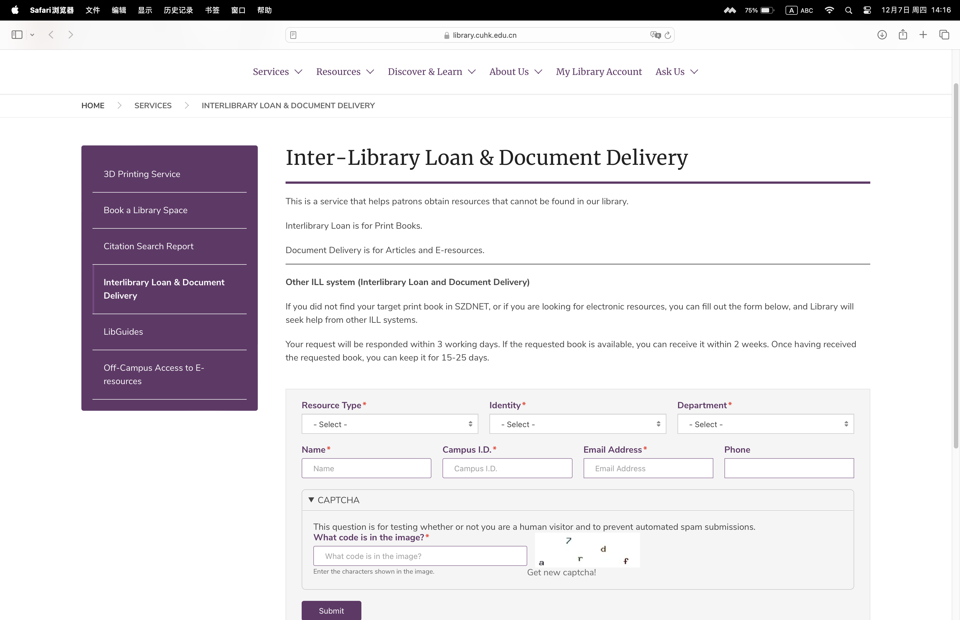
Interlibrary Loan
To request materials that are not in our library collection
https://library.cuhk.edu.cn/ajax/inter_library_loans

Slide 31
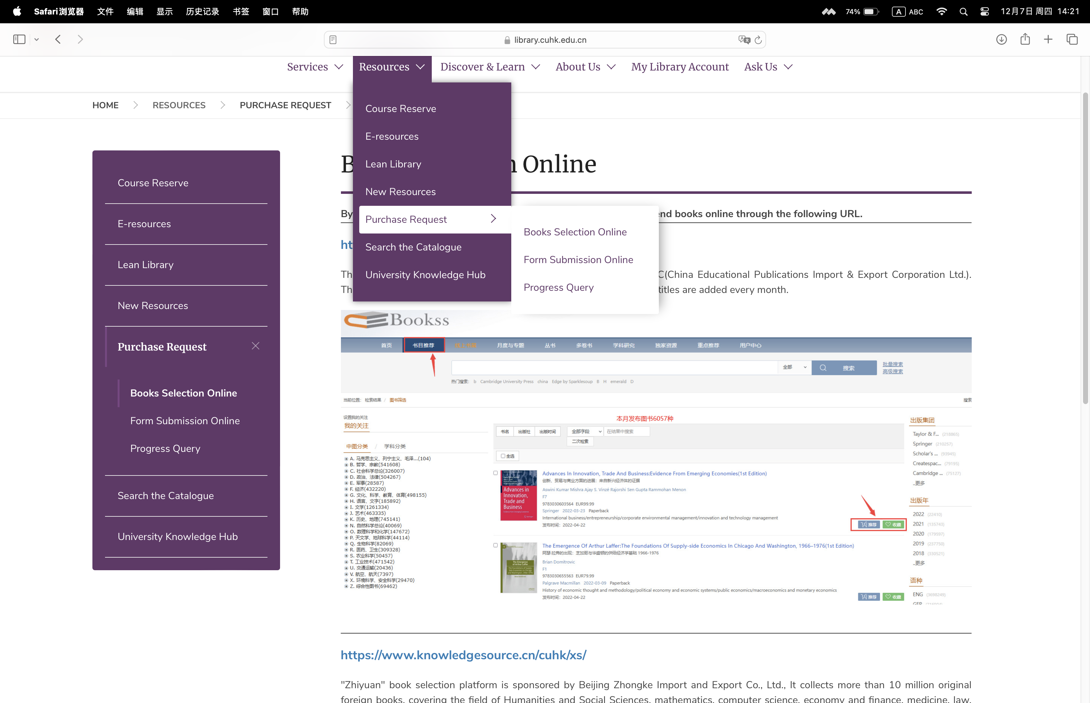
Purchase request
To request materials that are not in our library collection
https://library.cuhk.edu.cn/books-selection-online
https://library.cuhk.edu.cn/form-submission-online

Slide 32
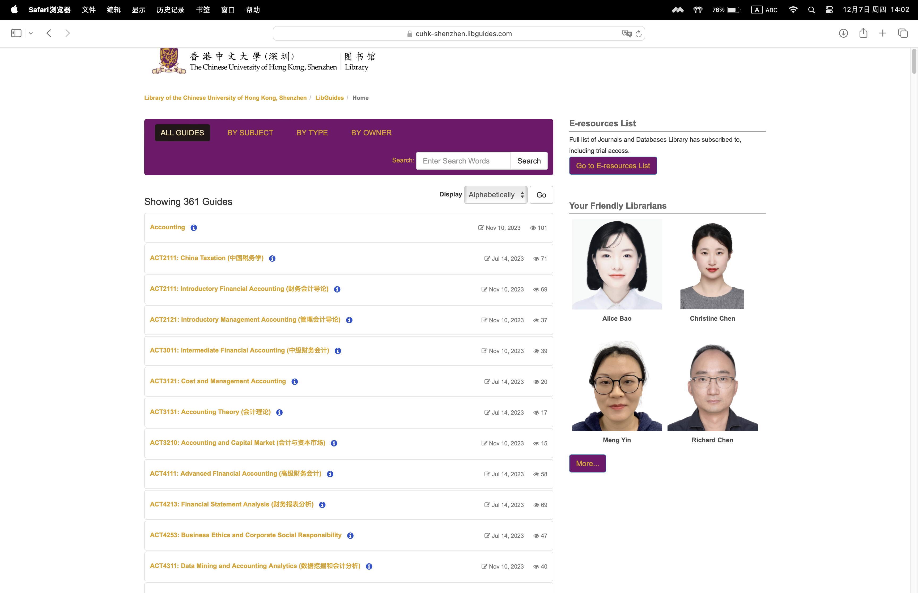
LibGuides
LibGuide pages that recommend library resources for courses and programs in our university
https://cuhk-shenzhen.libguides.com

Slide 33
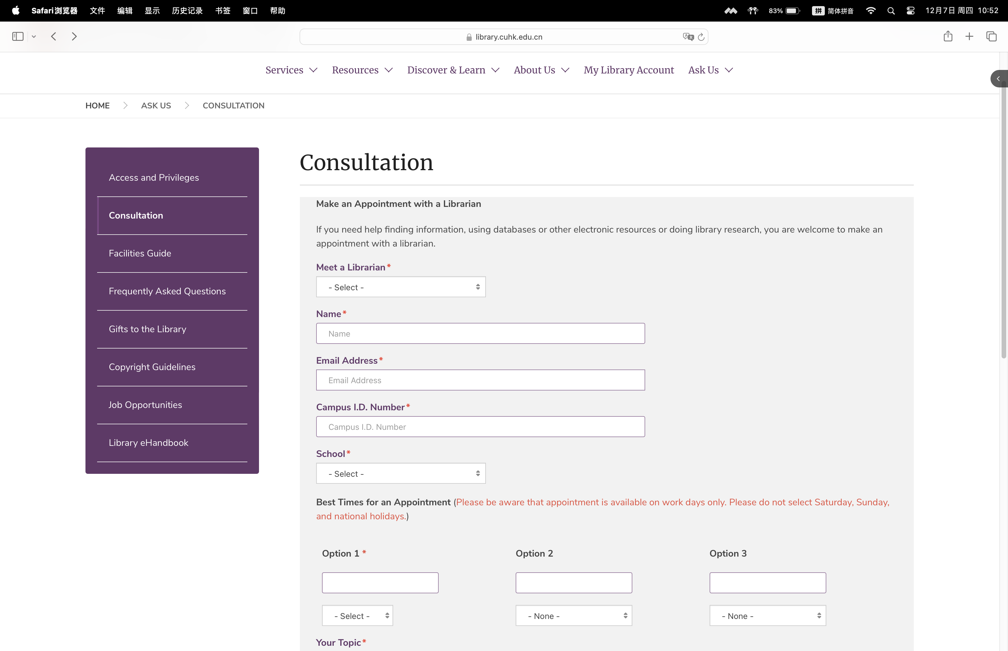
Consultation
Make an appointment with the Subject Service Librarians for questions such as how to search for library resources
https://library.cuhk.edu.cn/ajax/consultation

Slide 34
Thank you!

